Slide 1

CAE – 1
Problem Identification and Design Thinking
Presented by:
Aditya Bobde A – 21
Shivam Tawari A – 58
Vishal Narnaware A – 63
Presented to:
Dr. Gopal Sakarkar
Ph.D. in CSE
Department of Artificial Intelligence

Slide 2


AI in Logistics and Transportation

Slide 3

01
Define Brief
02
Research Background
03
Ideate Solution
04
Prototype Resolve
05
Select Rationale
06
Implement Delivery
07
Learn Feedback

Slide 4

The Problem
Logistics
Manual inventory tracking and stocktaking becomes unsuitable,
time-consuming and erroneous as company grows.
Chances of human error in Data Management.

Slide 5
The Problem
Transportation
Truck drivers are always under pressure to meet their target time.
Insufficient sleep causing Accident.

Slide 6
Number of Deaths in Truck Accident
2019
22,637 Deaths
25,108 Deaths
2018
2017
24,260 Deaths
26,215 Deaths
2016
2015
28,910 Deaths
Source : National Crime Records Bureau

Slide 7

Background Research
Warehouse takes 20% of all logistics costs.
India’s logistics industry has lagged behind its international counterparts
evident in its low rank of 44 on the World Bank’s Logistics Performance
Index in 2018 versus counterparts like China, and Vietnam.
Source: World Bank

Slide 8
Background Research
The industry is facing the shortage of truck drivers which majorly help
in improving transporters business.
Over 50% of drivers face health issues caused due to non-stop driving
The average speed of a truck in India is 30-40 kph compared with the
Global average of 60 – 80 kph with improvements in road conditions
and reductions in traffic congestion.

Slide 9
Ideate Solution
INVENTORY MANAGEMENT USING COMPUTER VISION
The goal of Computer Vision is to understand the data of digital images and interpret them beyond human vision.
We will be doing the analysis and categorization of images in an effective and scalable manner with state-of-the-art computer vision technology, which is based on neural network architecture.
Thus providing the templatized and guided workflows for our project

Slide 10
Ideate Solution
INVENTORY MANAGEMENT USING COMPUTER VISION
There are two kinds of Computer Vision templates offered :
Image classification Multiclass:
Multiclass classifies an image into one of two or more classes. It is a classification task with more than two classes.
Image classification Multilabel:
Here an image can be categorized into more than one class.

Slide 11
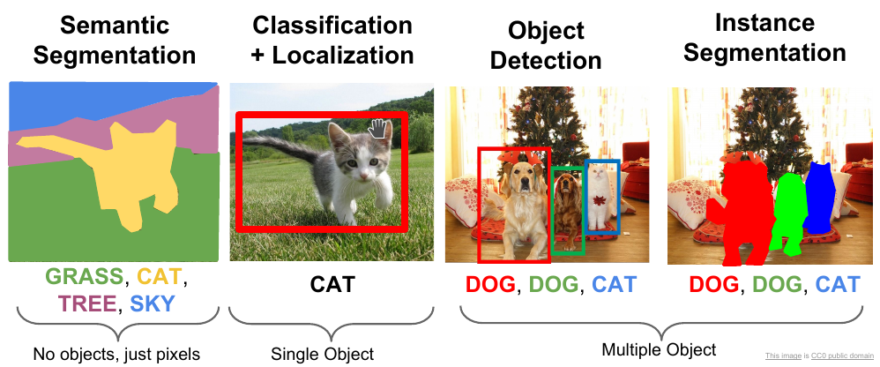
Prototype
INVENTORY MANAGEMENT USING COMPUTER VISION
Computer Vision will be used to build a smart inventory management for retail and in it we will be using Instance Segmentation.

Slide 12
Prototype
INVENTORY MANAGEMENT USING COMPUTER VISION
Key benefits:
It will be a unified AI Platform that enables Data Collection, Data Labeling, Data Visualization, Model training, deployment, and Monitoring.
Guided Machine Learning workflow makes it easy.
No infrastructure setup required.
Complete visibility at all stages.
Allows you to take your experiments to production in no time with scale.

Slide 13
Prototype
INVENTORY MANAGEMENT USING COMPUTER VISION
Computer Vision Inventory Management Solution that can figure out if items on the shelf are running low.
This prediction can be used to send notifications to employees for restocking thus removing the overhead of periodical checking of items on the shelves, whilst also driving revenues through high product availability.
We will collect various images of shelves in retail stores thus giving the required information.

Slide 14
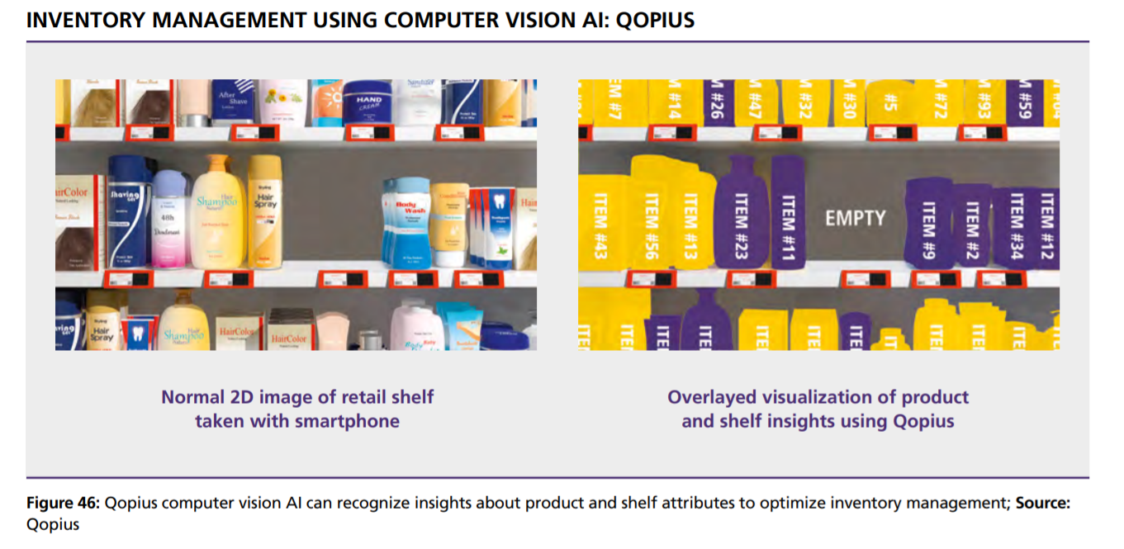
Prototype Working
INVENTORY MANAGEMENT USING COMPUTER VISION

Slide 15
Applications
INVENTORY MANAGEMENT USING COMPUTER VISION
Stock Taking
Reducing Human Counting
Detecting Damaged Goods
Stock Picking And Locating
Replacing Traditional Scanners

Slide 16
Ideate Solution
SEMI AUTONOMOUS SELF DRIVING TRUCKS
We propose a Semi Autonomous Self Driving Truck that'll be helping drivers most of the time, enabling the vehicle to perceive and predict changes in its environment.
Driver can switch in between Autonomous and Manual Drive mode.
This is useful whenever the Driver is feeling tired.
The AI agent will alert user whenever the situation might go out of hand.
This will help in reducing accidents.

Slide 17
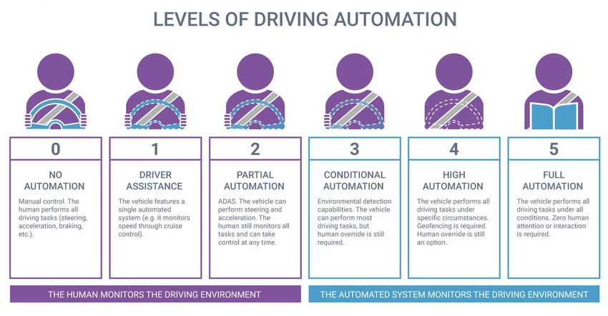
Ideate Solution
SEMI AUTONOMOUS SELF DRIVING TRUCKS

Slide 18
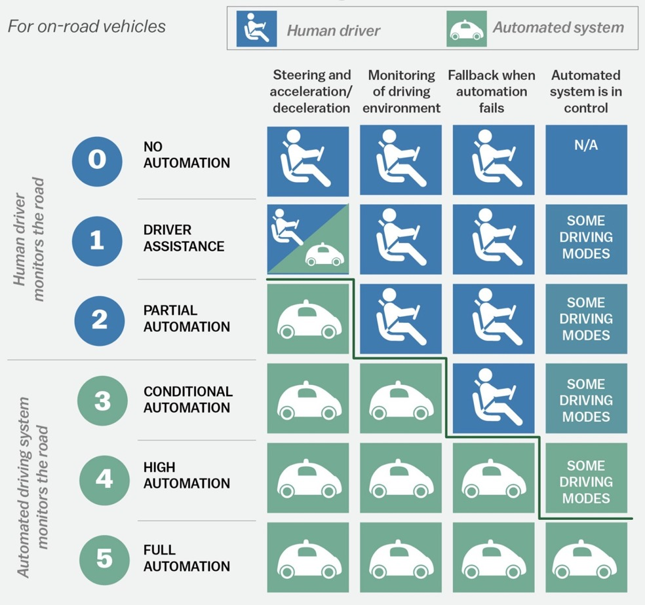
Ideate Solution
SEMI AUTONOMOUS SELF DRIVING TRUCKS

Slide 19
Requirements
SEMI AUTONOMOUS SELF DRIVING TRUCKS
Long Range Radar
LIDAR
Short/Medium Range Radar
Camera
Ultrasound
Notes:
Change Icons

Slide 20
Solution
SEMI AUTONOMOUS SELF DRIVING TRUCKS
Deep learning algorithms on board the vehicle process this live stream of environmental data.
Able to :
identify obstacles and other cars.
interpret road signs, street markings, and traffic signals.
comply with speed limits and traffic laws.

Slide 21
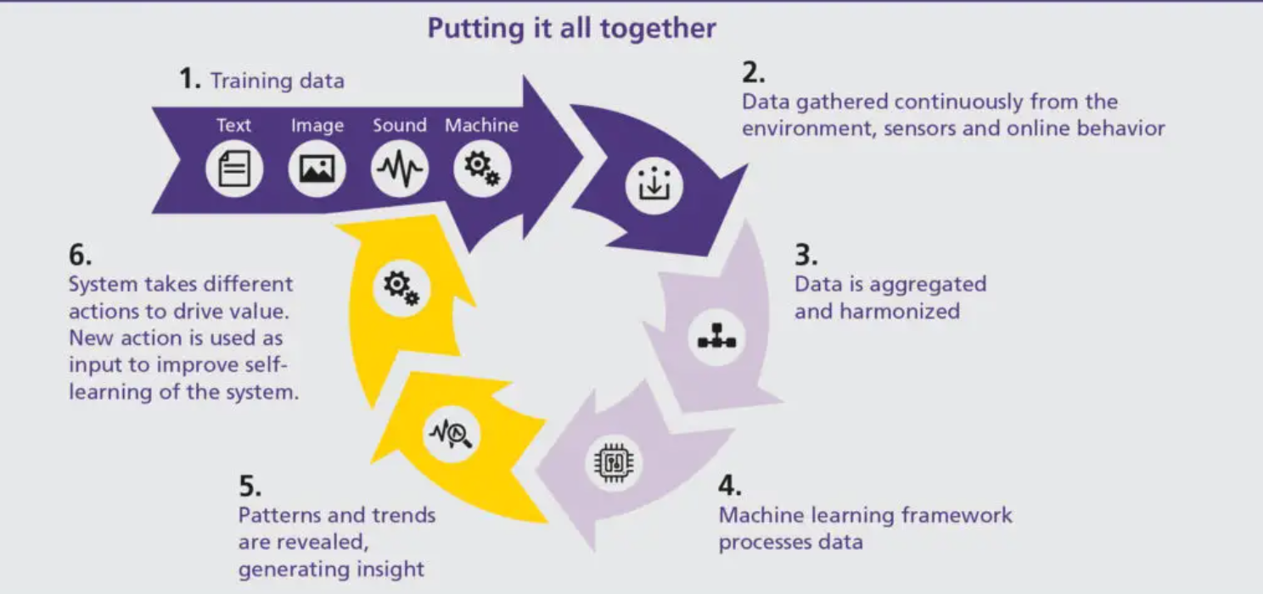
Prototype
SEMI AUTONOMOUS SELF DRIVING TRUCKS
Notes:
Kwality

Slide 22
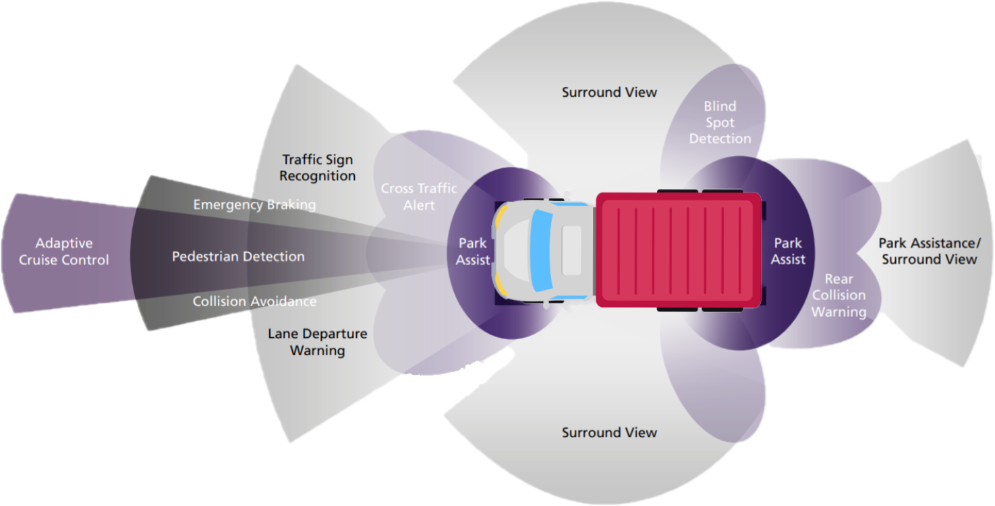
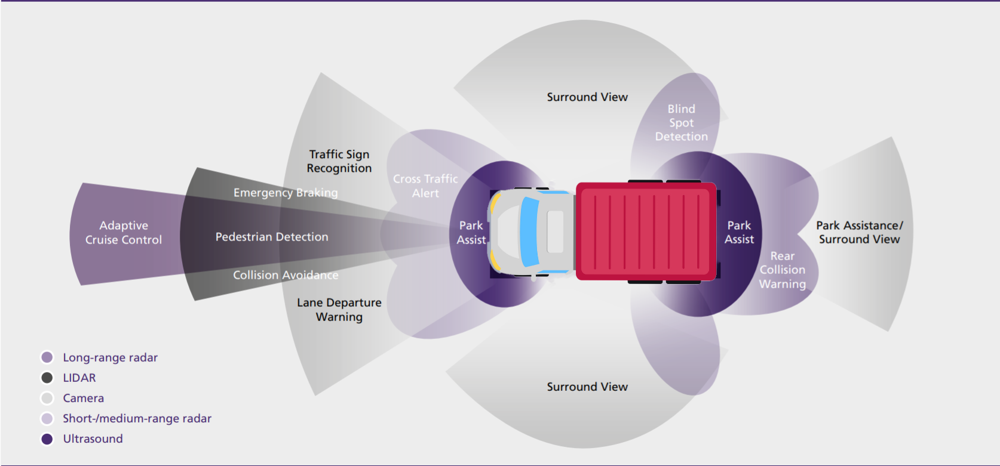
Prototype Working
SEMI AUTONOMOUS SELF DRIVING TRUCKS

Slide 23
Outcomes
SEMI AUTONOMOUS SELF DRIVING TRUCKS
Increased efficiency
Convenience
Fewer accidents

Slide 24

DOUBTS?

Slide 25
REFERENCES
National Crime Records Bureau - https://ncrb.gov.in/en/adsi-reports-of-previous-years.
Artificial Intelligence, Transport and the Smart City: Definitions and Dimensions of a New Mobility Era Alexandros Nikitas, Kalliopi Michalakopoulou, Eric Tchouamou Njoya and Dimitris Karampatzakis.
Artificial Intelligence In Logistics A collaborative report by DHL and IBM on implications and use cases for the logistics industry.
Autonomous Vehicle Technology : A Guide for Policymakers by James M. Anderson, Kalra Nidhi, Karlyn D. Stanley, Paul Sorensen, Constantine Samaras, Oluwatobi A. Oluwatola · 2014
Notes:
Ai & Quantum Computing For Finance & Insurance: Fortunes And Challenges For China And America
By David Kuo Chuen Lee, Paul Schulte · 2019

Slide 26
THANKS!

